Slide 1
Presentation of the Faculty of Transport and Traffic Sciences
Computer Vision Group
Hrvoje Gold
hrvoje.gold@fpz.hr

Slide 2
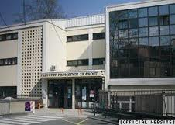
University of Zagreb
Faculty of Transport and Traffic Sciences
Faculty of Transport and Traffic Sciences
  Public institution of higher education, scientific and educational unit of the University of Zagreb
  Established in 1984
  15 departments
    Cover all transport modes (road, railway, urban, waterborn, information-communication, air, postal, logistics, ITS, aeronautics
  100 research staff members / 2200 students
  Publisher of the journal
  PROMET – Traffic & Transportation
    Cited in SCIE, TRIS, Geobase, FLUIDEX, and Scopus

Slide 3
University of Zagreb
Faculty of Transport and Traffic Sciences
Outline
Introduction
Equipment
Problems and approaches
Developed solutions
Results
Conclusion

Slide 4
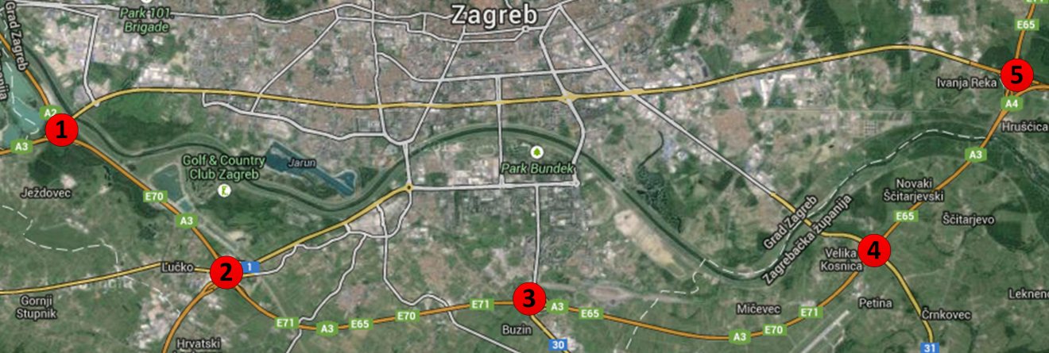
Introduction
Application of CV in road traffic
Research and development areas
  Algorithms for measuring road traffic parameters
    Possibility of extracting a large number of informations from video footage
    (distance between vehicles, velocity of vehicle, registration plate number – vehicle country of origin, origin-destination matrices, etc.)
  Road signalization status check
    Collaboration with Faculty of Electrical Engineering and Computing
Example
 |  |  | DESTINATION
 |  |  | NODE
 |  |  | 1 | 2 | 3 | 4 | 5
ORIGIN | NODE | 1 | 0 | 1921 | 1754 | 1421 | 1021
 |  | 2 | 1720 | 0 | 1872 | 1622 | 1524
 |  | 3 | 1821 | 1921 | 0 | 1722 | 1210
 |  | 4 | 1920 | 2011 | 1929 | 0 | 764
 |  | 5 | 656 | 1211 | 1644 | 1981 | 0
  Surveillance of main nodes of Zagreb road traffic network (marked with red points in the image)

Slide 5
Introduction
Group members
FTTS-CVG / name.surname@fpz.hr
  Prof. dr. sc. Hrvoje Gold, group leader
  Asst. prof. Edouard Ivanjko
  Asst. M.Sc. Marko Ševrović
  Kristian Kovačić, mag. ing. traff., PhD student
Faculty of transport and traffic sciences
  Vukelićeva 4, HR-10000 Zagreb, Croatia
  +385 (0)1 2380-222
  www.fpz.unizg.hr

Slide 6
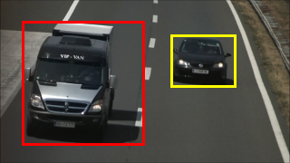
Introduction
Traffic parameters measurement consists of information extraction and analysis from video footage
Arised problems
  Detection and tracking of vehicles
  Estimation of vehicle trajectory

Slide 7
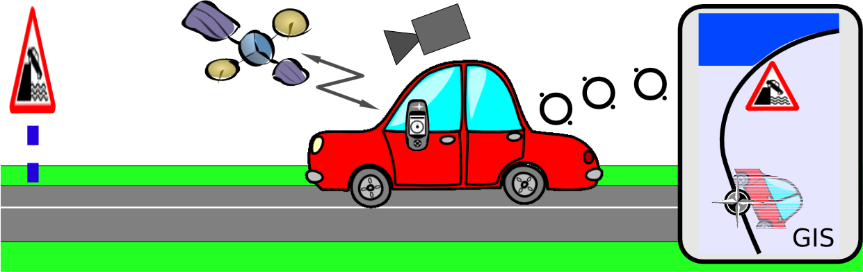
Introduction
Algorithms for road signalization check have been developed as an alternative to classic
on site road signalization inspections
Joint work with UNIZG-FER
Problem
  Detection of anomalies such as broken, covered, worn-out or stolen traffic signs, and erased or incorrectly painted lanes

Slide 8
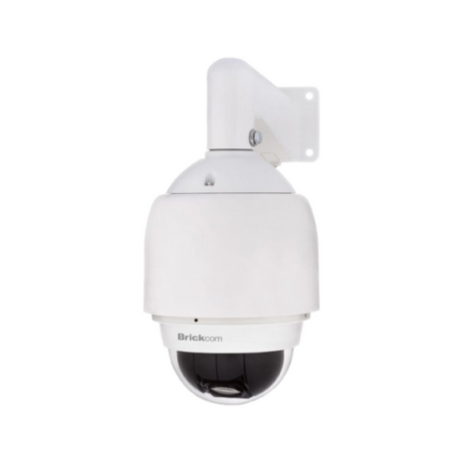
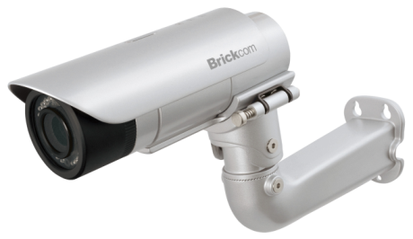
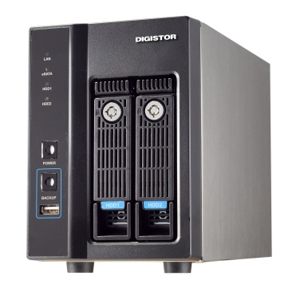

Equipment
Purchased equipment for measuring traffic parameters financed by project VISTA
  Lead by Faculty of Electrical Engineering and Computing
  4 fixed wireless IP cameras
  1 dome camera with pan-tilt-zoom functionality and LAN interface
  2 dome cameras with pan-tilt-zoom functionality and analog output interface (BNC) + 2 video servers used for A/D video signal conversion
  Network video recorder,
  wireless access points

Slide 9
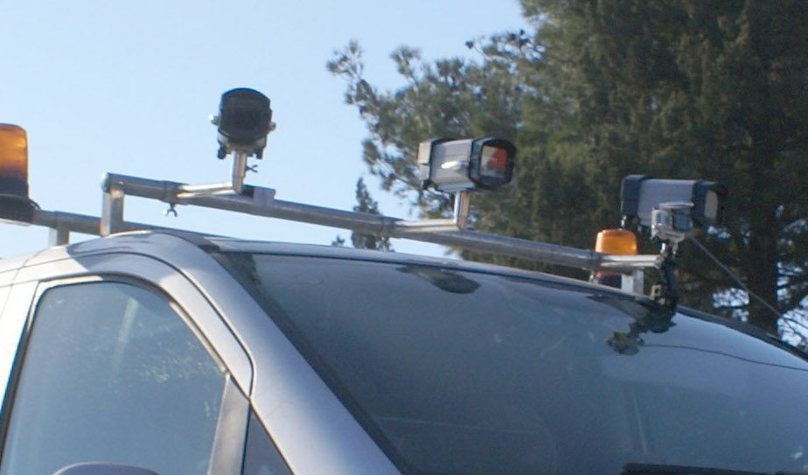
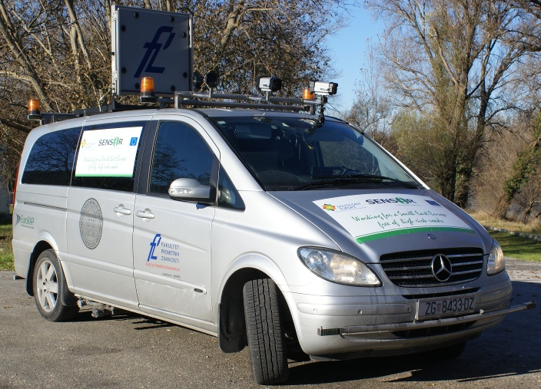
Equipment
Equipment used for road signalization check
  Road evaluation vehicle (equipped with HD cameras, GPS and retroreflectometer for measuring retroreflectivity of pavement marking and traffic signs)
UNIZG-FTTS is expert member of European Road Assessment Programme (EuroRAP)

Slide 10
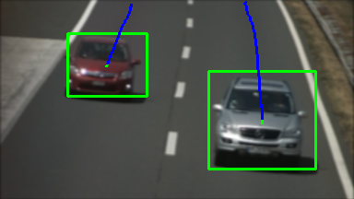
Problems and approaches
Problems of extracting traffic parameters for analysis of road traffic network and possible solutions
Detection and tracking of
vehicles
  Based on performing segmentation
  between objects of interest and
  noninterest objects using various
  image processing methods (Fg/Bg
  image segmentation, optical flow, Haar method, Hough method)
Estimation of vehicle trajectory
  Based on knowing vehicle location at certain time
  Describing vehicle movement by mathematical models which take into account vehicle dynamics
  Estimating next possible location (trajectory) of the vehicle

Slide 11
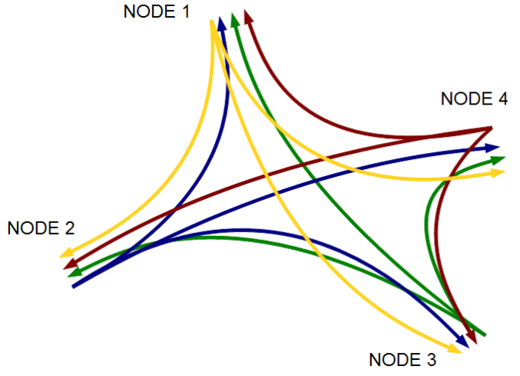
Problems and approaches
Problems of analysing road traffic network
Trajectory of moving vehicle through road traffic network (from node A to node B)
  Providing unique identification to each vehicle that is passing through road traffic network using automatic number (license) plate recognition
  Reduction of false positive/negative vehicles using additional statistical information given from origin-destination matrix

Slide 12
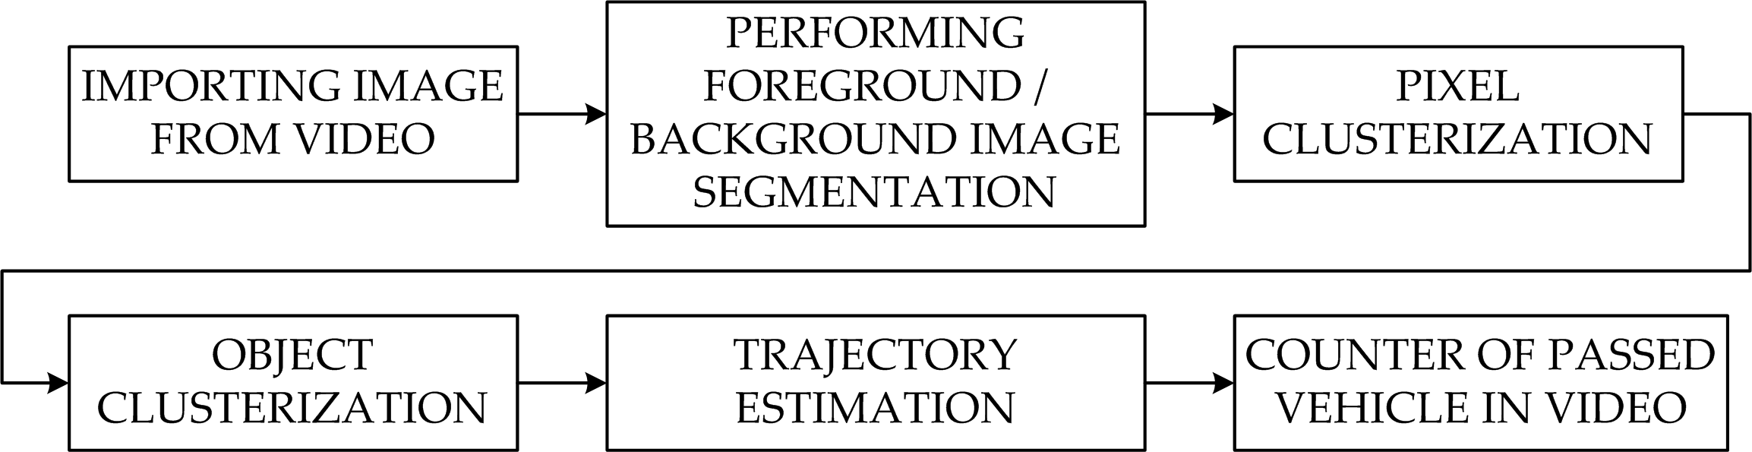
Developed solutions
Developed solution for measuring road traffic parameters
Used functions for image processing
  Gaussian blur used in image preprocessing for noise reduction
  Background image model computed with GPU shader
Developed system work flow

Slide 13
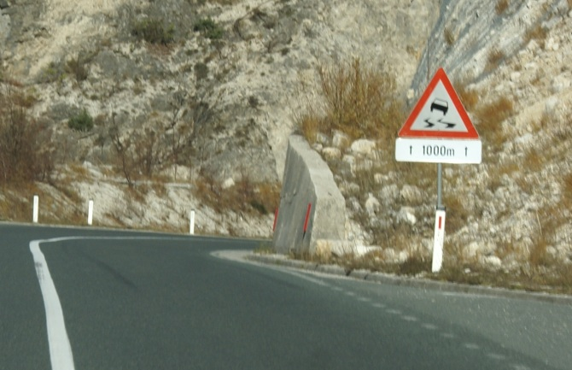
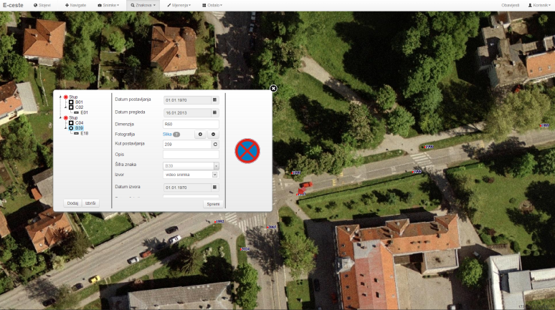
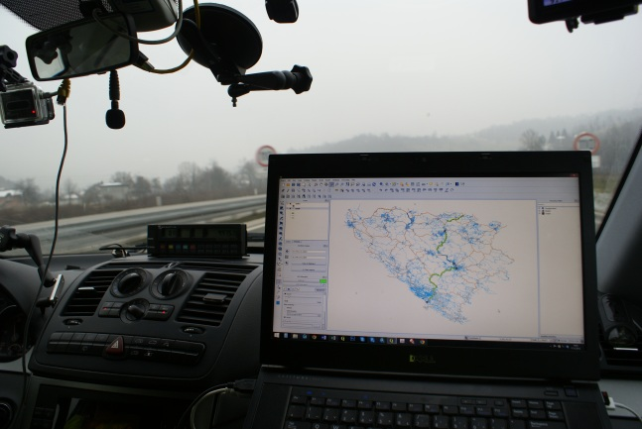
Developed solutions
Developed solution for road signalization check
Automatic comparison & verification of traffic signs with a GIS data base (partners: Faculty of Electrical Engineering and Computing, TU Graz, Tilda)
Acquisition of georeferenced video footage required for the application developed by UNI-ZG FER
Updating GIS database (E-ceste) with data obtained from developed application
Cooperation with Faculty of Geodesy in further analysis of obtained data

Slide 14
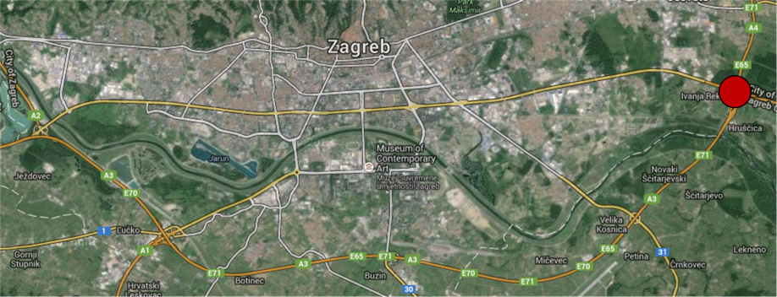
Results
Measuring road traffic parameters
LOCATION | IMAGE SIZE | RESULTS |  |  |  |  | EXECUTION TIME
 |  | LANE | VEHICLE NUMBER |  | FALSE POS. | FALSE NEG. | [ms] | [FPS]
 |  |  | REAL | DETECTED
Ivanja Reka | 384×216 | Total | 140 | 141 | 4 | 3 | 20-22 | 45-50
 |  | Left | 83 | 86 | 3 | 0
 |  | Right | 57 | 55 | 1 | 3
LOCATION OF CAMERA USED IN TESTING VIDEO
Arised problems
Overlapping vehicles
Environment conditions
(sun reflection, rapid lighting changes)
Camera vibrations due to strong wind or vehicle passing

Slide 15
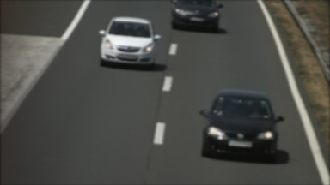

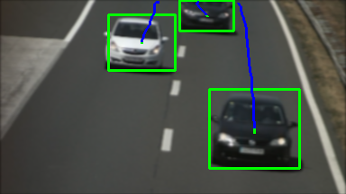

Results
Video footage from road traffic
  Vehicle recognition and identification using license plates
Detection of moving vehicle
Vehicle tracking
Country | Number of cars | Percentage [%]
Germany | 166 | 31.2
Poland | 88 | 16.5
Austria | 83 | 15.6
Czech Republic | 72 | 13.5
Croatia | 47 | 8.8
Others | 76 | 14.4
CARMEN Freeflow SDK

Slide 16
Conclusion
Future work
  Estimation of vehicle trajectory through road traffic network
  Detection and analysis of vehicle queue
  Determination of vehicle velocity
  Computation of origin-destination matrix of large road traffic network for purposes of traffic modeling
Cooperation possibilities related to implementation of new algorithms
  Vehicle classification algorithm robust to real outdoor environment
  Implementation of advanced trajectory estimation algorithm

Slide 17
Presentation of the Faculty of Transport and Traffic Sciences
Computer Vision Group
Hrvoje Gold
hrvoje.gold@fpz.hr

