Slide 1




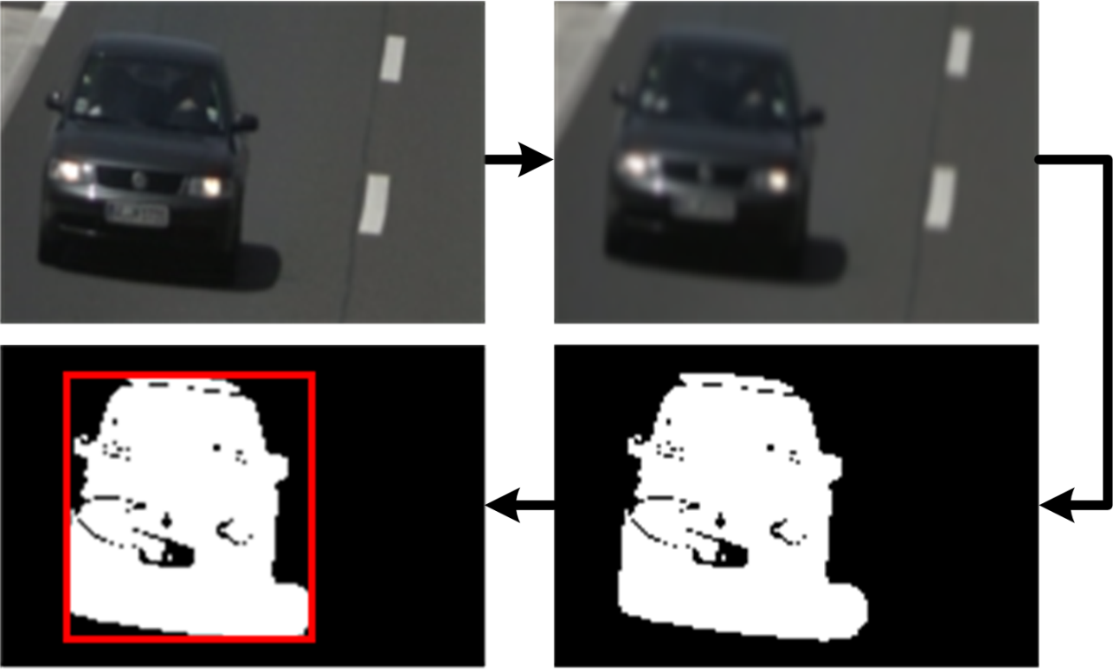
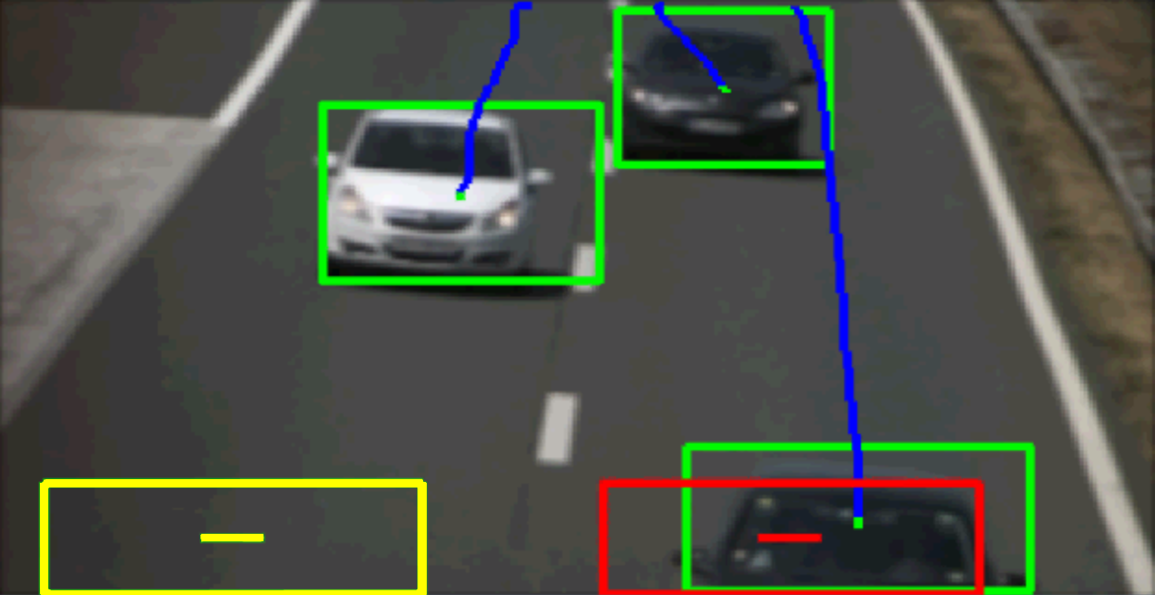
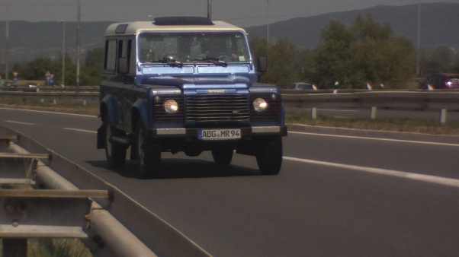
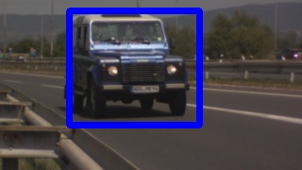
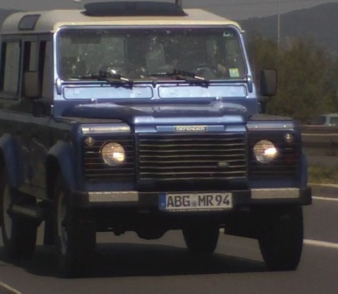
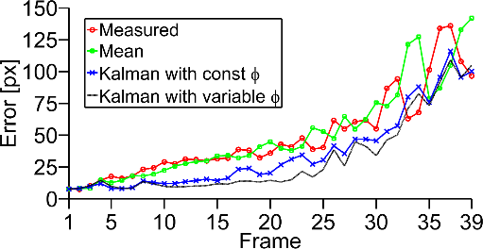
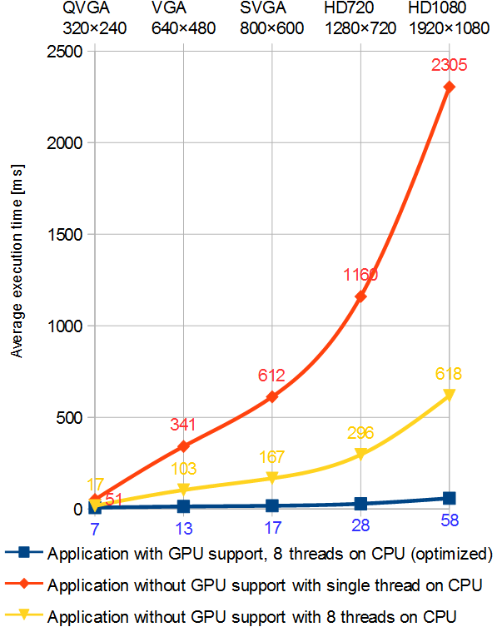
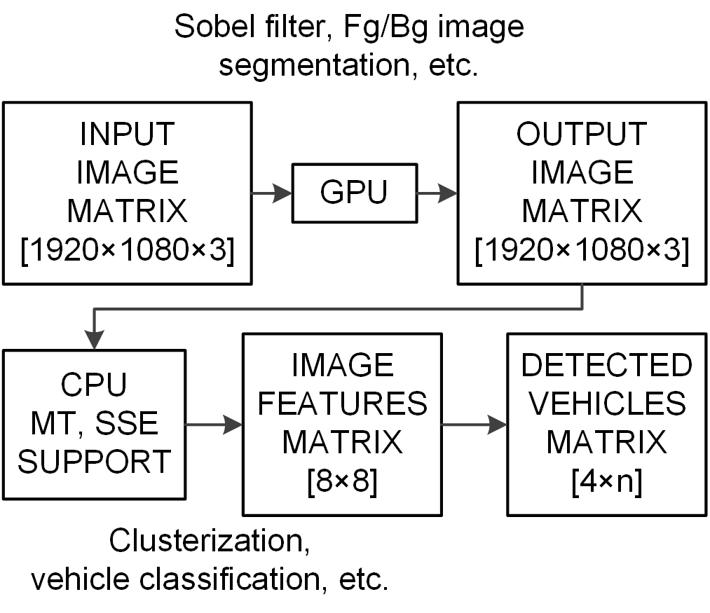
Measurement of road traffic parameters
based on computer vision
Kristian Kovačić | Edouard Ivanjko | Niko Jelušić | Hrvoje Gold
kkovacic@fpz.hr | eivanjko@fpz.hr | njelusic@fpz.hr | hgold@fpz.hr
University of Zagreb, Faculty of Transport and Traffic Sciences
www.unizg.hr, www.fpz.unizg.hr, its.fpz.hr
VISTA – COMPUTER VISION INNOVATIONS FOR SAFE TRAFFIC
Overall objectives:
  Strengthening of technology transfer and commercialization capacities of partner HEIs
  Transfer of existing computer vision applications from HEIs to SMEs
  Developing new traffic- and transportation-related computer vision applications with commercial potential in collaboration with SMEs in the automotive industry sector
Development of:
  Detection of road-side vegetation for traffic infrastructure maintenance
  Surround-view parking visualization
  Traffic sign detection and recognition
  Lane detection and recognition
  Lane departure and collision warning
  Automatic headlight detection
  Driver mental state recognition
Faculty of Electrical Engineering and
Computing (UNIZG-FER) leading institution
  Project leader: prof. dr. sc. Sven Lončarić
Faculty of Transport and Traffic Sciences (UNIZG-FTTS) partner institution
  Local project leader: prof. dr. sc. Hrvoje Gold
Project start date / duration: 30.03.2013. / 24 months
Project budget: 685,265.45 €
IMAGE PROCESSING
VEHICLE DETECTION
VEHICLE TRACKING AND COUNTING
Basic work flow of vehicle detection consists of:
Original image (a)
down sampled and blurred (b)
Creation of background image
model and comparison of
background image model and
current image (c)
Pixel clusterization and
grouping (d)
In the proposed system, spatio-temporal tracking of objects in a scene
is used for filtering
Every currently tracked
object in the scene is
compared with each
cluster detected in the
current image
When a vehicle passes
through marker and a hit
is detected, counter for
that marker is incremented
a)
b)
d)
c)
Counted vehicles in a video footage
from Croatian highway near Zagreb
VEHICLE ORIGIN DETECTION USING
LICENSE PLATE RECOGNITION
Approach |  | Vehicle count
 |  | Total | Left | Right
Overlap check | Hits | 126 | 65 | 61
 | FP / FN | 0 / 6 | 0 / 5 | 0 / 1
 | Accuracy [%] | 95,6 | 92,9 | 98,4
Trajectory check | Hits | 129 | 68 | 61
 | FP / FN | 1 / 4 | 0 / 3 | 1 / 1
 | Accuracy [%] | 96,2 | 95,8 | 96,8
Groundtruth |  | 132 | 70 | 62
1. Video input
2. Using contours for vehicle detection
3. Variable image size for
License Plate Recognition
OPTIMIZATION AND SPEED UP
4. Vehicle country
of origin distribution table
Execution time needed for processing of a single image
Country | Number of vehicles | Percentage [%]
Germany | 166 | 31.2
Poland | 88 | 16.5
Austria | 83 | 15.6
Czech Republic | 72 | 13.5
Croatia | 47 | 8.8
Others | 76 | 14.4
Computed error between estimated (EKF) and real trajectory
CONCLUSION & FUTURE WORK
Developed system uses only one camera to detect and track vehicles in real time on a road with multiple lanes
First testing results are promising with vehicle detection accuracy of over 95%
Future work consists of developing a multiple object tracking system which would perform vehicle classification and therefore separate vehicles by their type, compute origin-destination matrices by identifying each individual vehicle and tracking it through monitored road traffic network
Architecture of optimized application
ACKNOWLEDGEMENTS
This work has been supported by the IPA2007/HR/16IPO/001-040514 project “VISTA - Computer Vision Innovations for Safe Traffic” which is co-financed by the European Union from the European Regional and Development Fund.
22ND SUMMER SCHOOL ON IMAGE PROCESSING – SSIP 2014, ZAGREB, CROATIA

