Slide 1
Methodology for the dynamic interconnection of services for efficient multimodal transport networks (routing algorithm)
Multi-Modal Distributed Open Journey Planners webinar

Slide 2
Background
population of cities and suburban areas are constantly growing putting a pressure on transportation networks
supporting travellers to provide information and choose sustainable transport modes
effective door-to-door journey planner providing seamless information, combined solutions, and high comfort levels

Slide 3
History
2008: accelerate and coordinate the deployment of ITS applications
2011: general framework for a European multimodal journey planner
2016: EU-wide Multimodal Travel Information Services specifications
2017: standard of Open API (Application Programming Interface)
2019: system architecture for multimodal and distributed journey planners

Slide 4
Types of routing algorithms
optimization with analytical procedures (e.g. Dijkstra, Frederickson)
experiential or heuristic methods (e.g. A*, Genetic, Ant Colony)

Slide 5
Comparison of routing algorithms
 | Dijkstra | Frederickson | A* | Genetic algorithm | Ant Colony algorithm
Advantages | can map the whole network, simple algorithm | Divides big networks into small regions | does not overestimate the required resource of the trip, provides optimal solution | effective in choosing from several possibilities, appropriate for approaching global optimum search | optimum can be found relatively fast, protected against local optima, more ants can increase the efficiency
Disadvantages | uses too many resources, provides only one solution | only 3 levels (it is a problem in case of big networks), provides only one solution | a lot of memory is required, not applicable for big networks, provides only one solution | results are affected by randomization, results are never identical, can be stuck at local optimum | new ant requires extra resources, the probability to find the optimal route is low in case of low number of ants
Time requirement | Analytical algorithm $$O\left(n\log{n}\right)$$ | Analytical algorithm $$O\left(n\sqrt{\log{n}}\right)$$ | Heuristic algorithm | Heuristic algorithm | Heuristic algorithm

Slide 6
General aims
create a unified list of exchange points between the local journey planners to enable seamless routing
elaborate a routing algorithm providing optimized solutions
realize a seamless cross-border distributed journey planner

Slide 7
Framework
Open API CEN/TC 278 technical specification
responsible to ensure the connection and interoperability of the local journey planners
communication protocol to exchange requests with two-way authentication (REST: Representational State Transfer)
API services:
location information: geographical context, address resolution
exchange points: hubs, where trip calculation is handed over
trip request: intermodal trip info from origin to destination
distributed journey planning: multipoint trip request

Slide 8
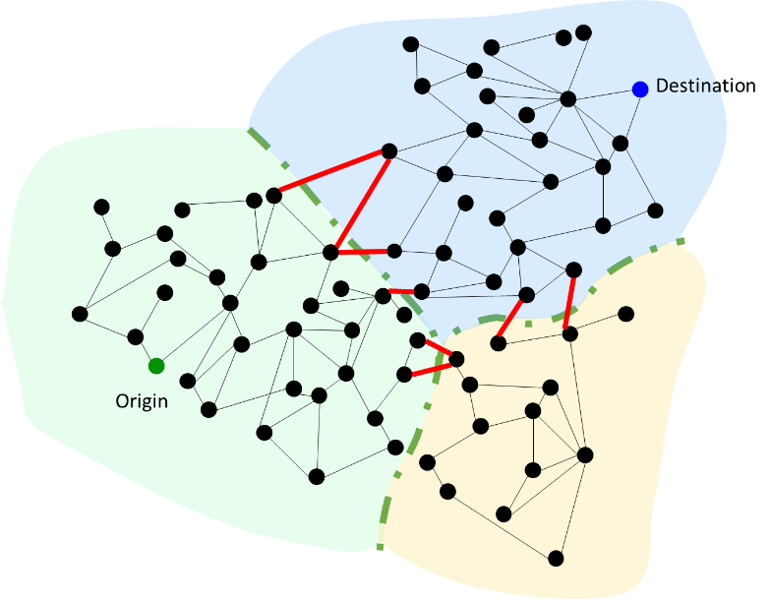
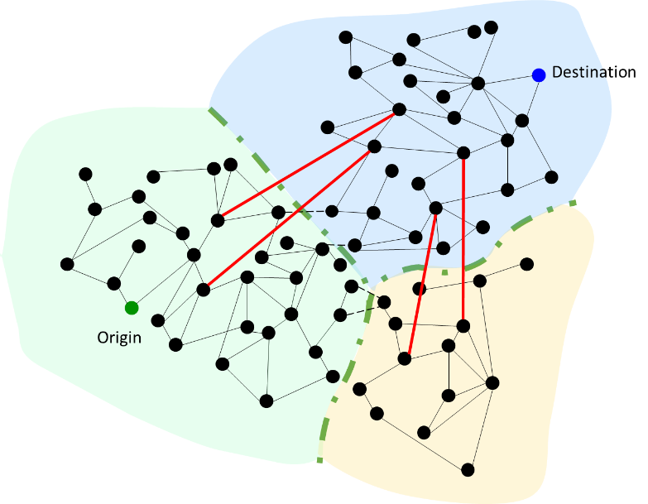
Exchange point types
border exchange points city exchange points (railway stop, bus stop) (railway station, bus terminal)

Slide 9
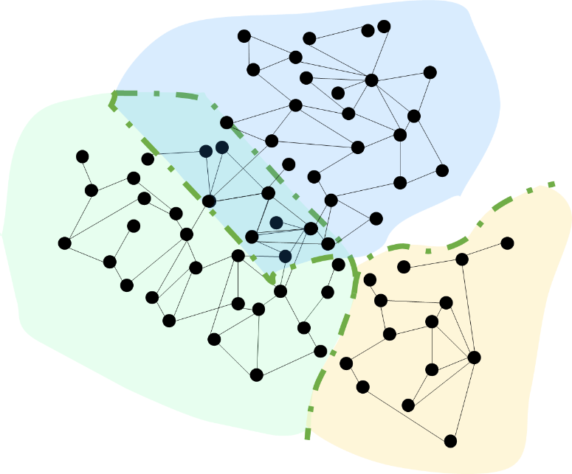
Exchange point method steps
load the static network with GPS coordinates of the stop points
load predefined list of exchange points
add these connections to the network
define walking distances between the points
identify feasible connections and mark them as exchange points (if walking distance is less than the predefined value)
add these connections to the network

Slide 10
Exchange point implementation steps
stop points are collected from the local journey planners (PT stops with GPS coordinates)
walking distance between the stop points is defined (1 km, 2 km, 3 km)
the algorithm identifies feasible connections and marks them as exchange points, if the walking distance between two stop points is less than the predefined value
the algorithm considers only stop points of different local journey planners, when identifying the exchange points
the list of potential exchange points are provided, and visualization is shown with Open Street Map

Slide 11
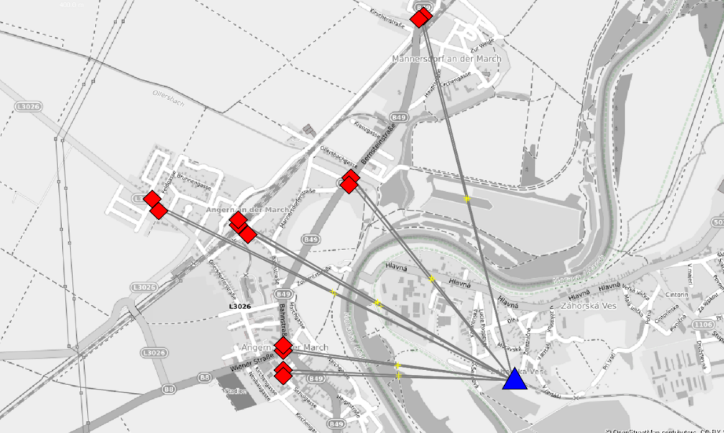
Exchange point example
26.500 stop points
6.655.000.000 potential connections
example at the Austrian and Slovakian border
3 km walking distance
Distance (km) | Number of exchange points
1 | 770
2 | 2290
3 | 5406

Slide 12
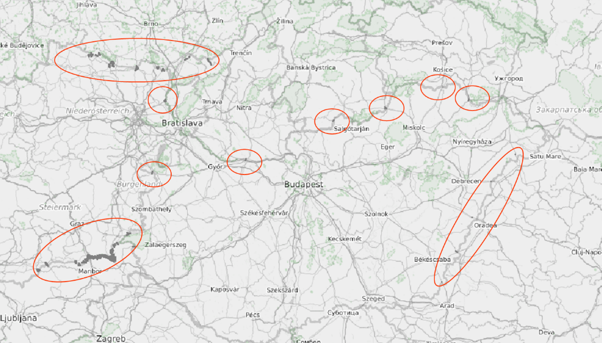
Exchange point results
full list with 3 km walking distance

Slide 13
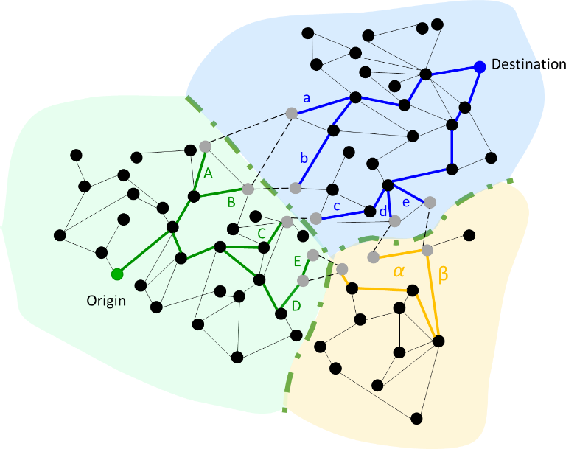
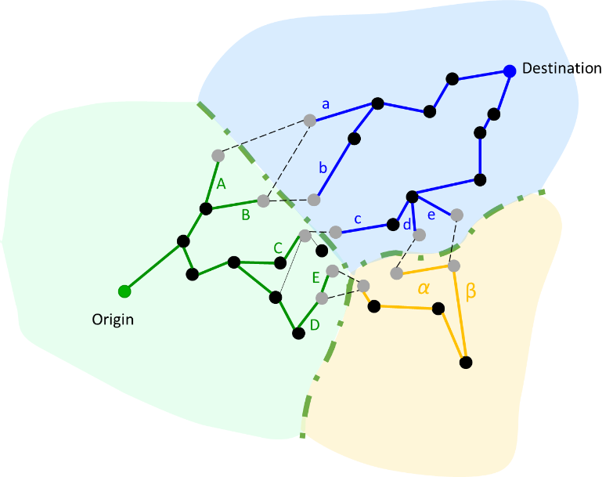
Routing algorithm network types
full network simplified network (with timetable information)

Slide 14
Routing algorithm method steps
create a static graph and calculate a preliminary minimum cost (e.g. travel time) for every option between the exchange points
in case of a specific search apply a threshold (for the cost) to filter the suitable exchange points
potentially change the level of threshold (start with a high threshold value, and then lower it, until the necessary number of route options is reached)
discard those route options, which are above the threshold, and thus are not suitable connections
calculate the exact routes for the remaining routes
several parameters can be considered (e.g. travel time, cost, environmental effects) during the calculation
the best options are provided as the results for the user

Slide 15
Routing algorithm implementation steps
based on the list of potential exchange points and distance information between the stop points of the local journey planners, the heuristic algorithm calculates a rough estimation of the travel times (this part is done offline in advance)
a threshold is defined for route planning options (e.g. max 8 hours trips)
based on these estimations, if a trip request appears, the options above the threshold are not considered
a heuristic ant colony algorithm is realized in Java
the exact routes are calculated based on real-time information from the local journey planners for the remaining exchange point options
in this way the routes receive a utility value, which can be compared, and a ranking is possible

Slide 16
Routing algorithm ranking
Routing considerations
Ant Colony algorithm
utility function as an input
not all options will be explored (heuristic)
Ranking considerations
Input: utility function with parameters
utility function has to be elaborated using the routing parameters
weights have to be defined based on user groups
Output: ranked list

Slide 17
Methodology for the dynamic interconnection of services for efficient multimodal transport networks (routing algorithm)
Thanks for your attention!

