Slide 1
Knowledge transfer to Western Balkan Countries and Moldavia
Yannick Cornet
on behalf of CDT team
University of Zilina (UNIZA) Eradiate+ team

Slide 2
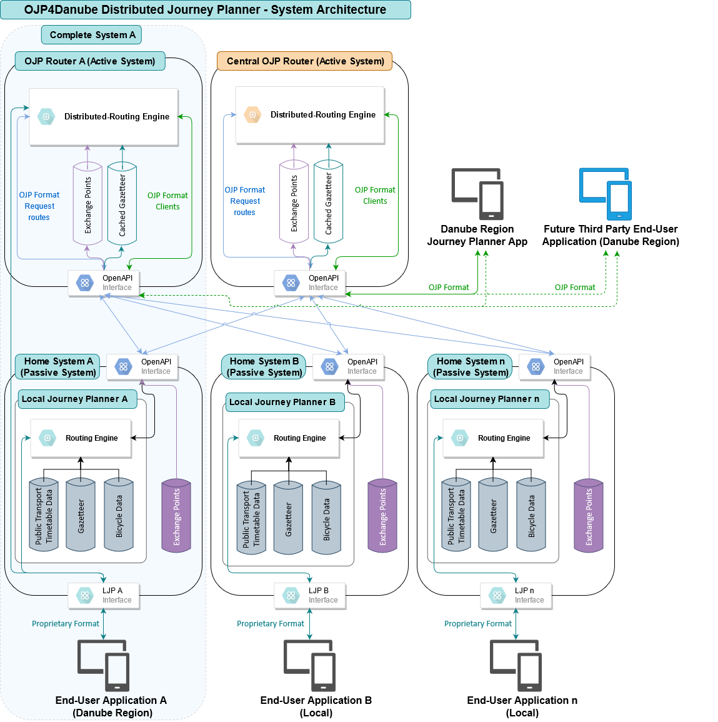
Danube Region Journey Planner (DRJP) App
Sits on top of the system architecture
User-friendly demonstrator of OJP4Danube features
Web-based + native Android/iOS versions

Slide 3
Result: 8 key features for multimodal, cross-border journey planning (D.T2.1.1)
F1: Walk distance
Priority 1
Walking (or cycling) distance to a public transport stop
Whether taking an eco-friendly vehicle onboard is permitted
International bicycle routing, overlapping with Eurovelo routes where possible
Priority 2
Type of cycling infrastructure
Avoiding ascents or total elevation
Platform access facilities e.g. elevators, stairs
Availability and characteristics of dedicated bicycle parking at end points
Integration of shared eco-friendly modes systems (bike-sharing, e-scooter sharing)
Priority 1
F2: Bike onboard
F3: Bike routing (Eurovelo)
F4: Bike infrastructure
Priority 2
F5: Ascents&elevation
F6: Platform facilities
F7: Bike parking
F8: Shared bikes

Slide 4
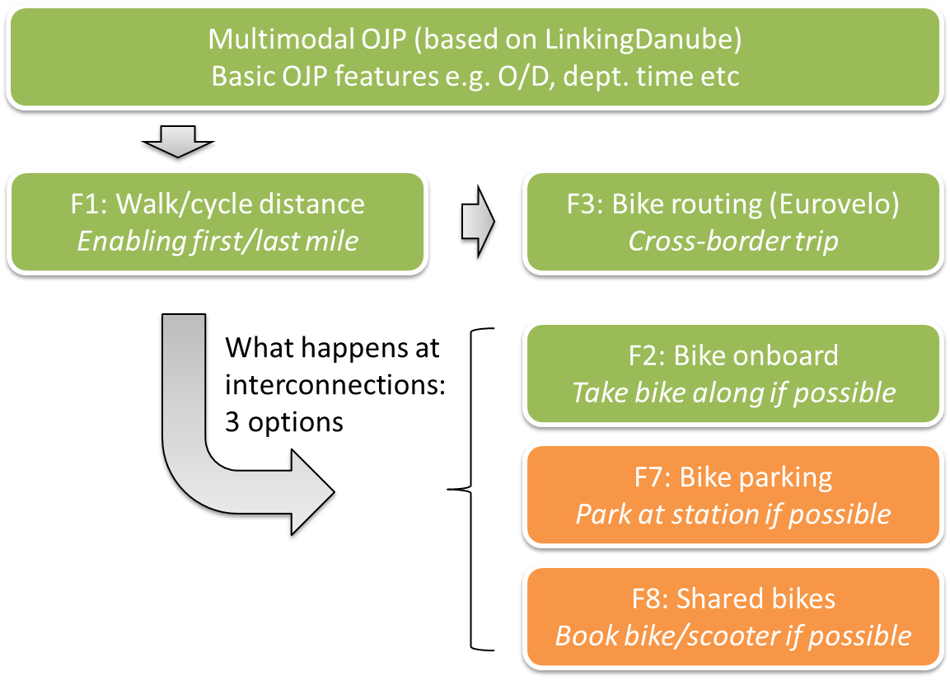
Final selection
F1-F3: confirmed, including data harmonisation and UI implementation on minimum two TISPs (Eurovelo as output only)
F7-F8: interest but requires changes to OJP4 profile standard; UXI design will be provided
F4-F6 dropped (lack of support)

Slide 5
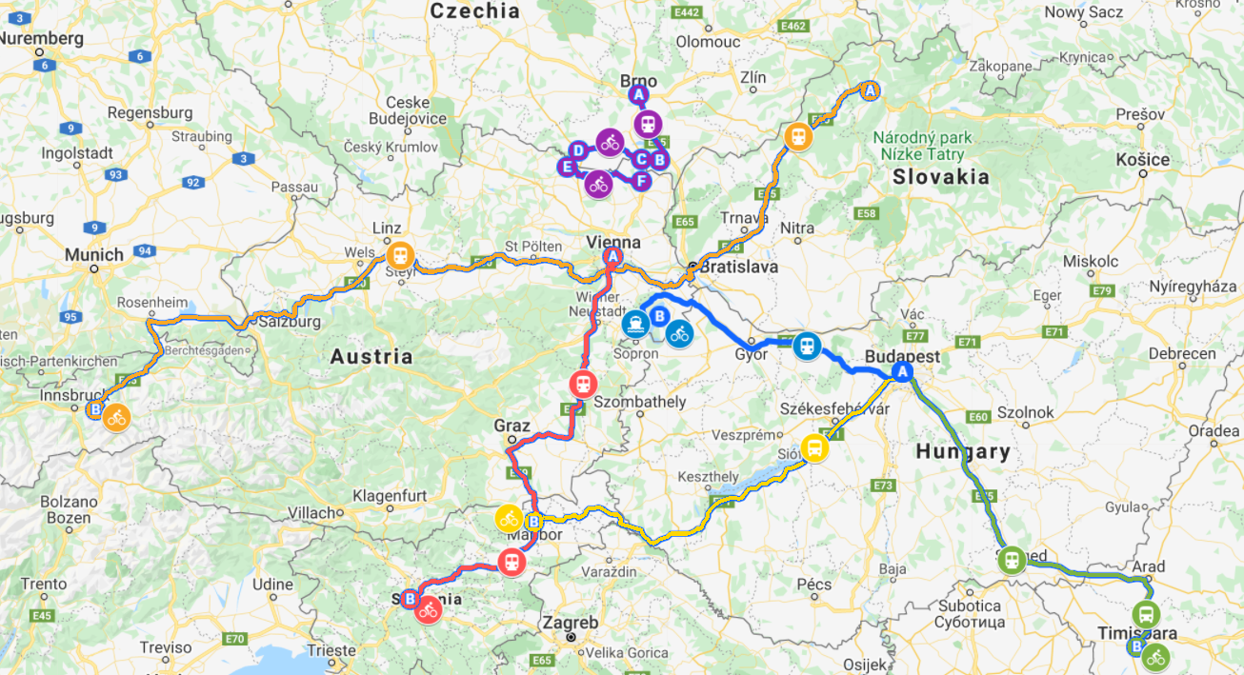
Use-case and features

Slide 6
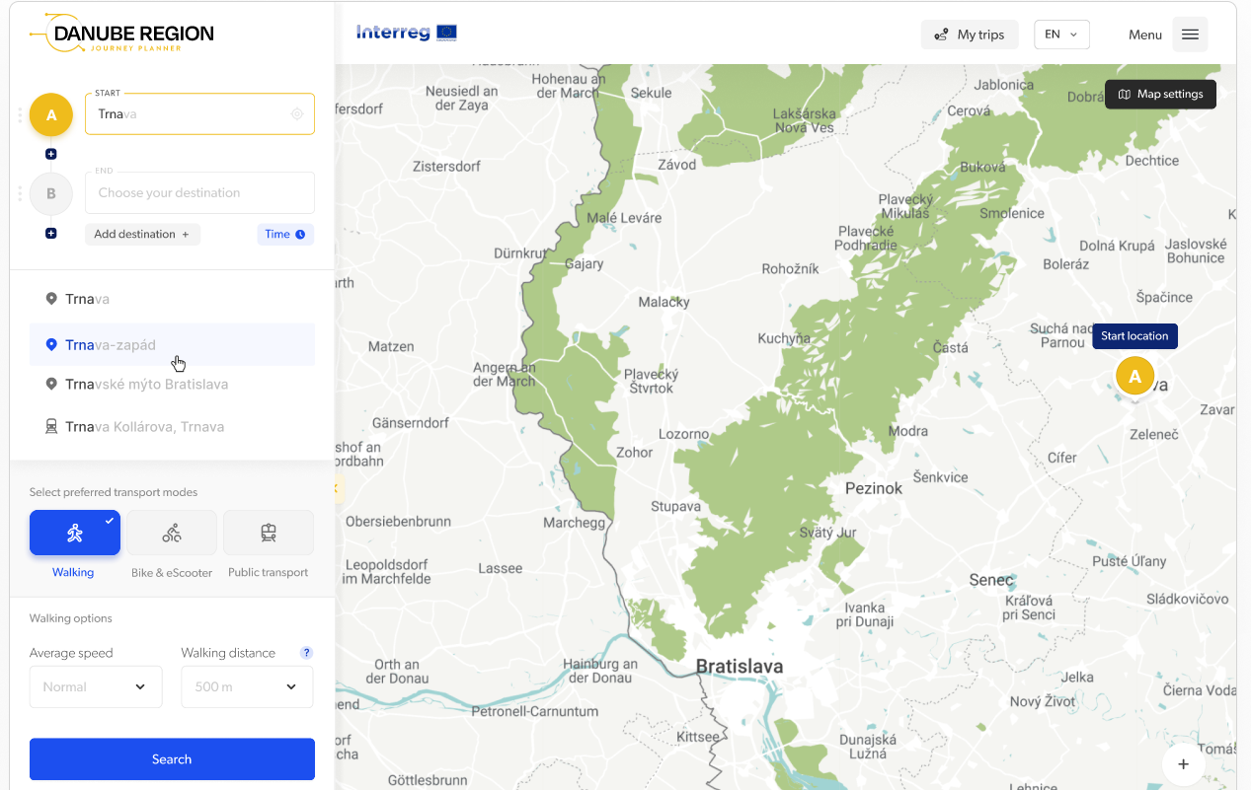
Summary of key UI design issues (D.T2.5.1)
Autocomplete can work in real-time, but a dedicated Search button is required due to expected latency in returning routes
Walking is inevitable in any door-to-door trip
Maximum walking distance as input set to 500m (from literature) door-to-door trip

Slide 7
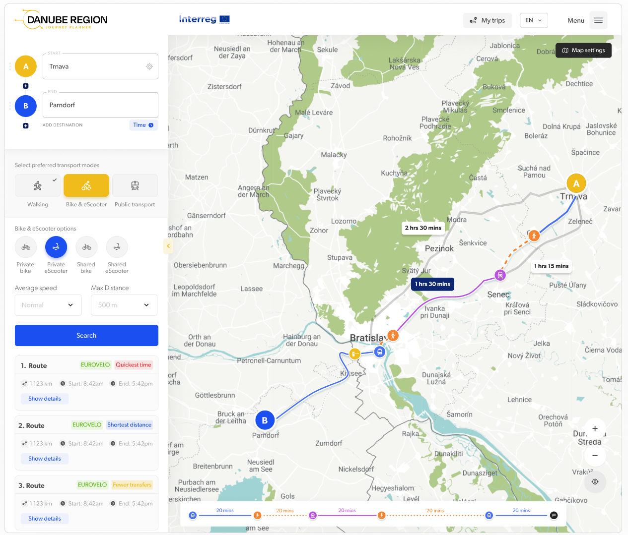
If Bike/eScooter is selected, the routing assumes it is the preferred mode for first- and last-mile over walking
Private or shared bike and scooters were added under the micromobility mode.
Routing preferences not as input but as output:
Quickest time
Shortest distance
Fewer transfers
EUROVELO (i.e. partly overlaps Eurovelo route)
Border crossings are visible on the map
Map and trip timeline is displayed for selected trip

Slide 8
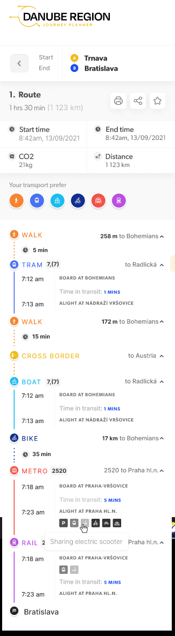
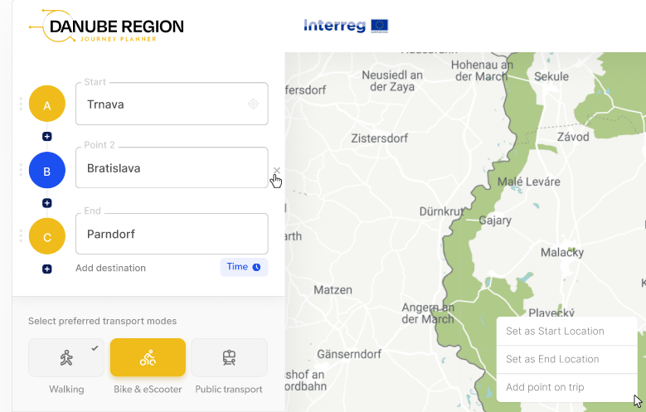
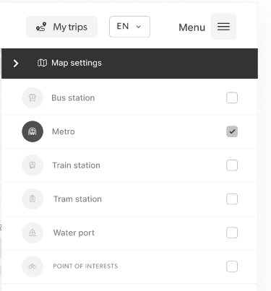
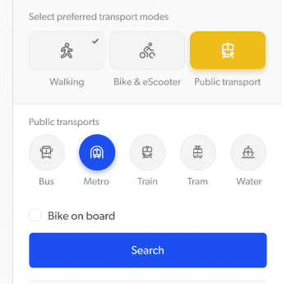
Possibility to add waypoints
…
… also directly on the map
Possibility to print, share or save a route
Full route breakdown when selected
Five public transport modes
Map settings for display options (stations and POIs)
Bike onboard added to PT mode as an input option when both Bike and PT are selected

Slide 9
Thank you!
https://app.ojp4danube.eu/#/
Questions?
yannick.cornet@uniza.sk
Workshop, 7th of October 2 022, Vienna

