Slide 1
Dissemination of the OJP in the academic community and academic course on OJP
1st Workshop on Knowledge Transfer to Western Balkan Countries

Slide 2
Objective
Transfer the know-how on OJP approach and standard to future adopters and use it as input for educational as well as vocational training
Webinar/academic course on OJP and intermodal route planning
Dissemination within the academic community

Slide 3
Webinar/Academic course on Open Journey Planning and intermodal route planning, including cycling

Slide 4
Aim
Transfer of knowledge on
OJP approach and standard
Integration of cycling information in multimodal trip planning needs
Innovative approaches
The extension of existing public transport that are the foundation of OJP Standard
To whom?
Students and possible future adopters
OJP implementers and developers
Infrastructure and (public) service providers
Local, regional and national public authorities
Higher education and other institutions

Slide 5
Technical background and design
WordPress
Learning Management System (LMS)
The ability to create course-like content: lessons, quizzes, files, grades, media, etc.
LearnPress
Comprehensive WordPress LMS Plugin
Used to easily create online courses with lessons and quizzes
A user interface for online courses with several options
Export and import courses to another website
Manage course - statistics about the number of students, trends, etc.
Communication with students
Free
Language
English
The course is hosted on the website ojp4danube-edu.net

Slide 6
Main course page
Link - https://ojp4danube-edu.net/courses/multi-modal-distributed-open-journey-planners/
Title
Duration - lifetime access is set
Level - beginner
Requirements
Features
Targeted audiences
Overview - course objectives, course teachers and learning outcomes
Developed as a part of Interreg project OJP4Danube.
Licensed under a Creative Commons Attribution-NonCommercial-NoDerivatives 4.0 International License
Comment
Curriculum – seven sections, lessons, quizzes, questions, etc.
Unlimited number of students
Re-take course - unlimited
Pricing - free
Evaluation - by the number of quizzes passed per total number of quizzes
Passing grade - 60%

Slide 7
Lesson page
Title
Content
Lecturer
Lesson file is embedded within the lesson webpage
The streaming video of the lecturer presenting the presentation
The duration
Discussion
Comments
Search box
Sidebar overview
Progress status

Slide 8
Quiz page
Title
Number of questions, duration and passing grade
General information about the quiz
The topic covered
Types of questions
Points
No penalty points
Questions
Question types
Single choice – only one correct answer
True or false – binary question marking
Multi-choice – multiple correct answers
Duration
No hints, explanation or negative marking
Infinite number of retakes
Review

Slide 9
Finishing the course

Slide 10
Exploitation plan
The course can easily be customized in terms of duration time, content and the course difficulty level
Currently, the developed online course is suitable for the enrolment of English-speaking students
Academic community
To integrate the course and outcomes of the course within the institutions’ study programs, highlighting the importance of more sustainable transport
Online webinar tool
Where the know-how knowledge on multi-modal distributed open journey planners is transferred from OJP4Danube project partners to any interested party
Created online available PowerPoint lessons and videos can be used without the need for a user to take the quizzes
After the project closure
The course can be used for the dissemination of the project know-how to any interested party
The long-term project results may eventually lead to the OJP API-based journey planners on a European-wide network of open journey planning information systems, where a developed course could act as a stepping stone that contains aggregated and informative content on the OJP concept and implementation
The developed course will be active for at least four years after the project closure, which is ensured by the ojp4danube-edu.net internet domain that is secured for that period

Slide 11
Dissemination within academic community

Slide 12
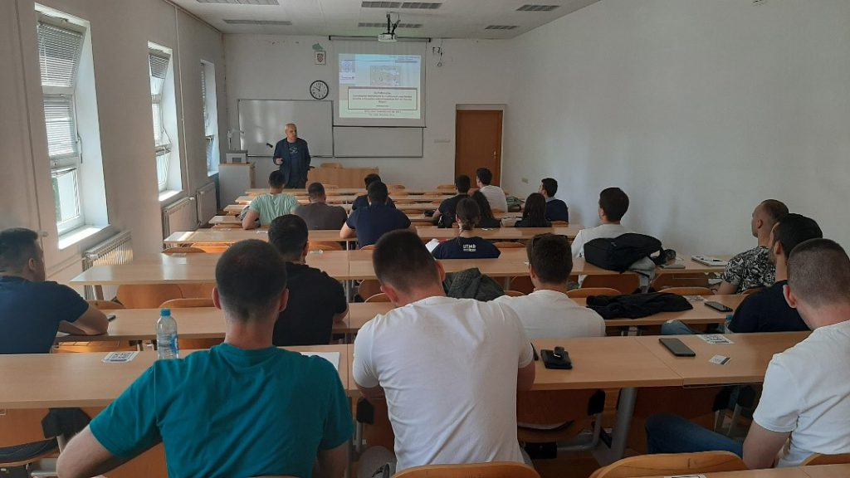
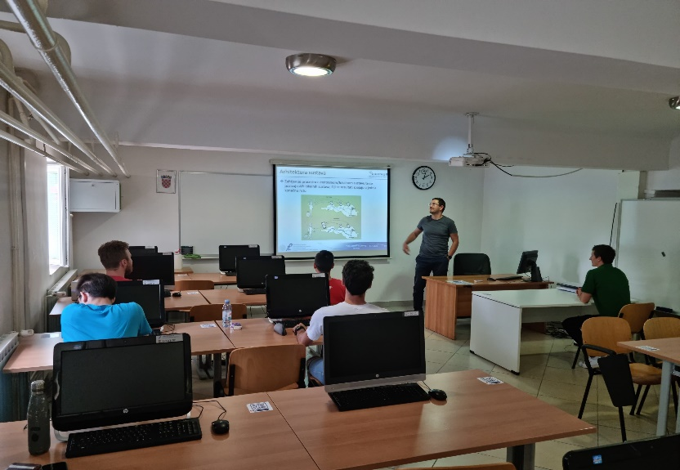
Lectures
Four lectures on the topics related to the concept of distributed multi-modal OJP
Faculty of Transport and Traffic Sciences, University of Zagreb
Courses: Intelligent Transport Systems I and Intelligent Transport Systems II

Slide 13
Proposed academic course
The ZITS project partners proposed a new course titled “Multi-Modal Distributed Open Journey Planners” within the currently developing new study program and curriculum at the Faculty of Transport and Traffic Science
The materials for the proposed course are directly adopted from the developed online course
The proposed academic course will primarily be held in the Croatian language, but it will also be open to the foreign students
The proposed course consists of a detailed syllabus which contains information about the teachers, ECTS, hours of lectures and seminars, learning outcomes, course objectives, student evaluation methods, detailed course topics (15), etc.

Slide 14
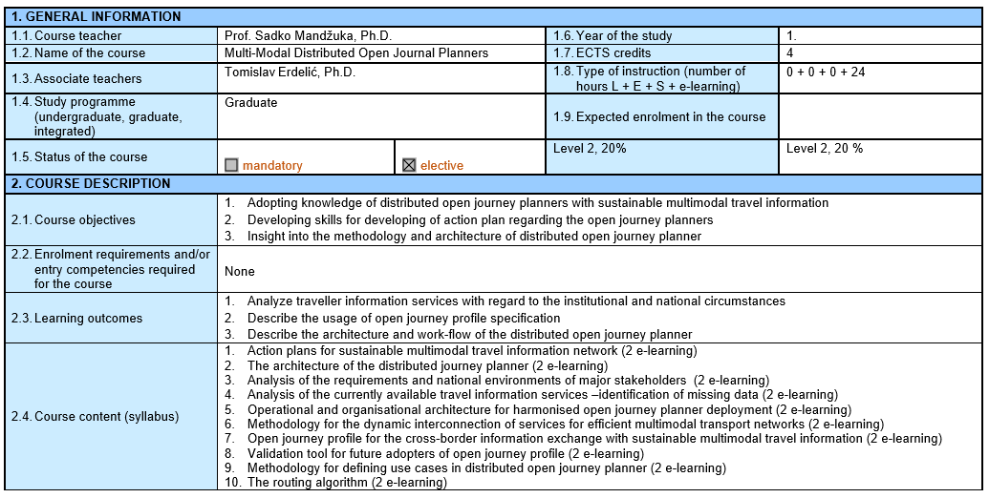
Proposed academic course

Slide 15
Thank you!
terdelic@fpz.unizg.hr

