Slide 1
Description of the work plan of the 2nd workshop and explanations of the tasks for participants from individual countries
OJP4Danube
A.T4.4 “Knowledge transfer to Western Balkan Countries"
D.T4.4.1"Concept for the knowledge transfer (workshop)“

Slide 2
Goal of the 2nd workshops
The second workshop’s aim is to discuss about the current status of providing multimodal passenger information services in West Balkan countries (legal, organizational, digital infrastructure etc.) and to examine the possibilities on OJP deployment in Western Balkan countries.
The workshop itself is aimed at a smaller group of participants (relevant stakeholders).
The specific topics of the workshop are the following:
Current status of national environments in the Western Balkan countries
Plans for OJP deployment in Western Balkan countries
Possibilities on OJP deployment in Western Balkan countries

Slide 3
Agenda- Workshop #2
09:00 | Welcome | ZITS
5’ | Welcome by ZITS [Tomislav/prof. M] | ZITS
15’ | Introduction of agenda [Tomislav/prof. M] | ZITS
9:20 | Current status of national environments
10’ | Introduction [Krešo] | ZITS
30’ | Discussion [All participants] | all
10:00 | Plans for OJP deployment in Western Balkan countries
15' | Introduction [Krešo] | ZITS
30’ | Discussion [All participants] | all
10:45 | Coffee break
11:00 | Possibilities of WB OJP deployment and future steps
15’ | Introduction [Krešo] | ZITS
30’ | Discussion [All participants] | all
11:45 | Wrap-up and summary [Tomislav/prof. M] | ZITS
15' | Conclusions | ZITS
12:00 | End of Workshop

Slide 4
Agenda- Workshop #2
09:00 | Welcome | ZITS
5’ | Welcome by ZITS | ZITS
15’ | Introduction of agenda | ZITS
9:20 | Current status of national environments
10’ | Introduction | ZITS
30’ | Discussion | all
10:00 | Plans for OJP deployment in Western Balkan countries
15' | Introduction | ZITS
30’ | Discussion | all
10:45 | Coffee break
11:00 | Possibilities of WB OJP deployment and future steps
15’ | Introduction | ZITS
30’ | Discussion | all
11:45 | Wrap-up and summary | ZITS
15' | Conclusions | ZITS
12:00 | End of Workshop

Slide 5
During the 2nd workshop, let’s try to discuss and find answers for following questions:

Slide 6
1. Legal prerequisites
Status of legislation in field of traffic/multimodal information exchange?
Strategy/action plan regarding traffic/multimodal data collection, exchange and usage?
Awareness about existing EU Directives and Delegated actions in this area and their requirements?

Slide 7
2. Organizational prerequisites
Identify key stakeholders in traffic/multimodal information exchange:
Transport authorities
Transport operators
Infrastructure managers
Transport on demand service providers

Slide 8
3. Current operational status
Existing data exchange points for traffic/multimodal data?
National access point, open data portals etc…?
Existing journey planners?
On city level, country level, per operator, crossborder etc…?
Availability of data within existing stakehoders?
Is data collected, avaible or published?
Is data collected in standardized format (Datex, Netex, Siri, GTFS?...)
Existing crossborder cooperation on travel/multimodal data exchange?

Slide 9
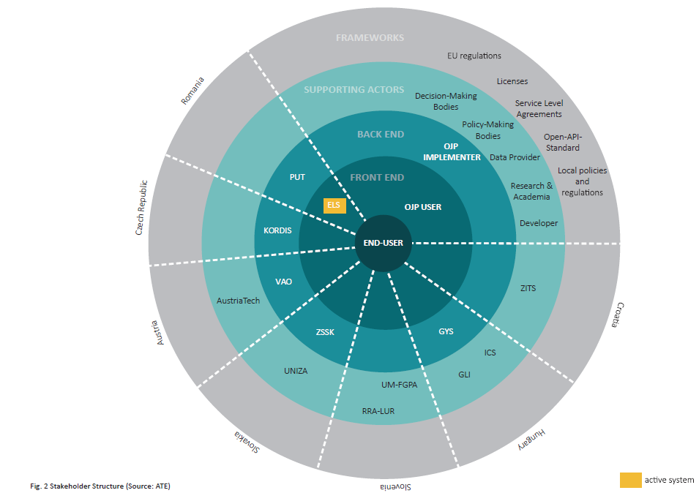
4. Plans & possibilities for OJP deployment in Western Balkan countries
How would the plan for OJP deployment look like in your country?
Identify key stakeholders and their responsibitilies
Try to identify:
Users
Implementers
Supporting actors
Try to draft action plan for OJP deployment

Slide 10
Conclusion
On workshop, we will:
Discuss on high level status and (pre)requirements listed above
Try to reuse existing knowledge and experience in order to avoid common pitfalls
Recognize the role of this types of services in fulfillment of goals of global transport strategy
Be presented with demo of operating NAP

Slide 11
Thank you for your attention!

Slide 12
OJP4Danube Strategy Map

